Slide 1
Aggregation on Dot map
Group 7
Jiaqi Ni
Kalina Petrova
Radu Stoica

Slide 2
Content
Introduction
Data generation
Problem definition
Proposal solutions
Constraints

Slide 3
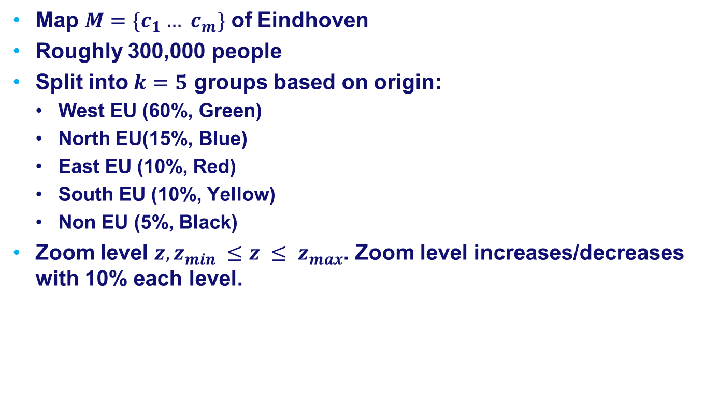
Introduction
Map $M=\{c_{1}… c_{m}\}$ of Eindhoven
Roughly 300,000 people
Split into $k=5$ groups based on origin:
West EU (60%, Green)
North EU(15%, Blue)
East EU (10%, Red)
South EU (10%, Yellow)
Non EU (5%, Black)
Zoom level $z, z_{min} ≤z ≤ z_{max}$. Zoom level increases/decreases with 10% each level.

Slide 4
Data generation
Randomly generated data
Placement of dots inside regions of the map
Regions with higher population density have higher priority

Slide 5
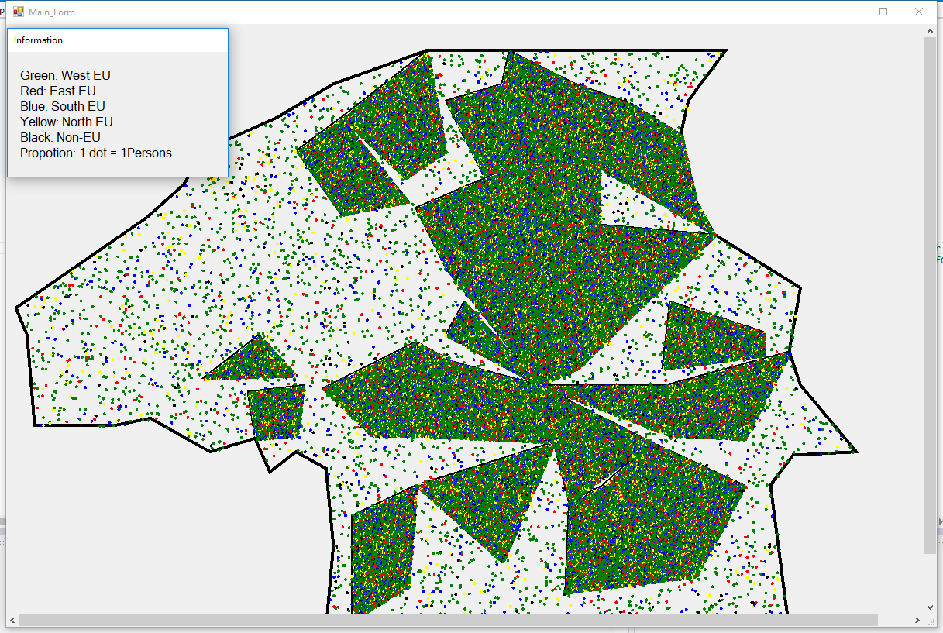
Eindhoven

Slide 6
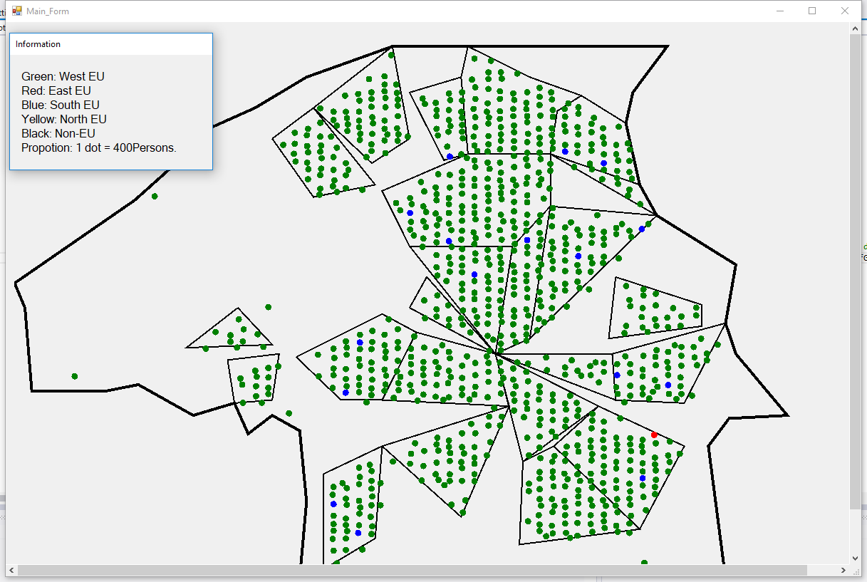
With proper aggregation

Slide 7
Problem definition
Ratio of people per dot at zoom level.
Splitting of dots into groups.
Size/radius of the dots.
Location of the dots.
Color of the dots.

Slide 8
People per dot
For better display, say we want the distance between each dot is at least 70 pixels.
Then we would have at most (window width / 70 / zoom in level) * (window height / 70 / zoom in level) = m dots.
Let n = total number of people, then there would be roughly n / m people in each dot.
We round the number, for instance, 12,390 will become 10,000; 103 will become 100 etc.
We apply the rounded number to the aggregation algorithm.

Slide 9
Splitting dots into groups
Recursive algorithm that splits region into 4 until the region has less or equal to the number of the group size.

Slide 10
Splitting dots into groups
Number of dots of each cell need to reach the minimum percentage (20%) of the maximum number

Slide 11
Size/radius of dots
For better display, we want the distance between each dot is at least, say 70 pixels.
Then we would have the radius of the dot =
min(window width, window height) / 70 / zoom in level / 5
5 is here for some distance between other dots.
Zoom in level 1 means each dot = 1 person.
For better visibility, we give a minimum radius of the dot, for instance 4.

Slide 12
Location of dots
Location
Overlapping solution

Slide 13
Location of dots
Where to place the dot.
Choose the middle dot’s position
Dots are stored in a list
Average of all chosen dots’ positions

Slide 14
Location of dots
Solve the overlapping

Slide 15
Coloring dots
Choosing color palette
Several solutions depending on ratios

Slide 16

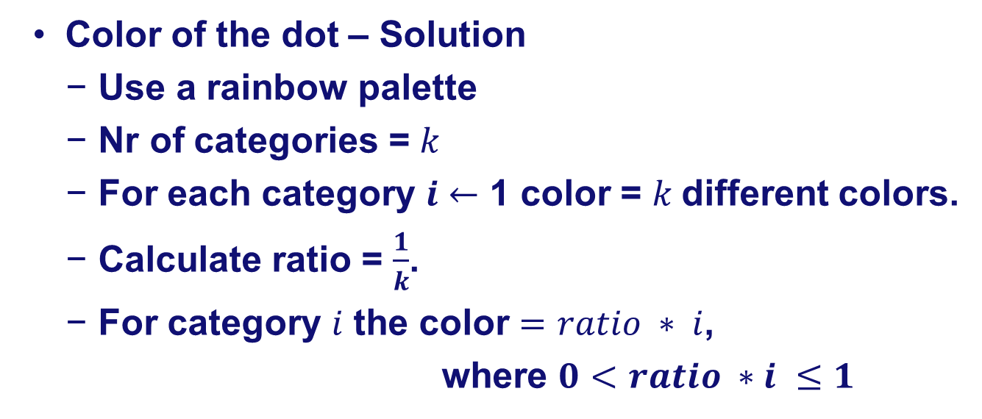
Choosing color palette
Color of the dot – Solution
Use a rainbow palette
Nr of categories = $k$
For each category $i$ $←$ 1 color = $k$different colors.
Calculate ratio = $\frac{1}{k}$.
For category $i$ the color $=ratio ∗ i$,
where $0<ratio ∗i ≤1$

Slide 17
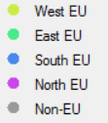
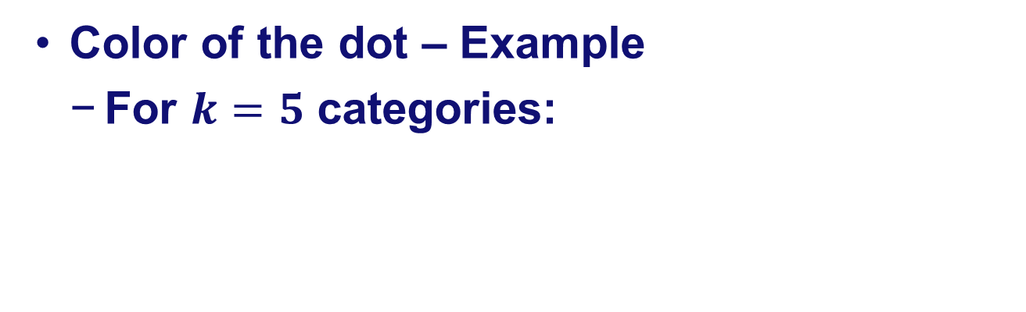
Choosing color palette
Color of the dot – Example
For $k=5$ categories:

Slide 18
Coloring dots
Solution 1
50% green
20% blue
10% red
10% yellow
10% black

Slide 19
Coloring dots
Solution 2
50% green / 60% green
20% blue /15% blue
10% red /10% red
10% yellow /10% yellow
10% black /5%black

Slide 20
Coloring dots
Solution 3 (implemented)
50% green / root 60% green
20% blue / root 15% blue
10% red / root 10% red
10% yellow / root 10% yellow
10% black / root 5%black

Slide 21
Coloring dots
Solution 4
50% green / root 60% green
20% blue / root 15% blue
10% red / root 10% red
10% yellow / root 10% yellow
10% black / root 5%black

Slide 22
Running time
Radius of the dot = O(1)
How many people = 1 dot = O(1)
Where to place the dot = O(n)
Choose the middle point (O(1) * n)
Solve the overlap (O(n))
Color of the dot = O(n)
Solution 3 (O(n))
Total running time = O(n^2)
n = total number of people

Slide 23
Demo

Slide 24
Constraints
Data generation is slow O(N), where N = total number of people.
One time only, as long as the data.txt is not deleted.
Aggregation algorithm’s worst case Running time is O(N^3), where N = total number of people.
Each time when the proposition (number of people to 1 dot) changes.

Slide 25
Constraints
Special case 1
West EU (20%, Green)
North EU(20%, Blue)
East EU (20%, Red)
South EU (20%, Yellow)
Non EU (20%, Black)
people are distributed like this:
r1,r2,r3,r4,r5,r1,r2,r3,r4,r5 ….
Special case 2
West EU (96%, Green)
North EU(1%, Blue)
East EU (1%, Red)
South EU (1%, Yellow)
Non EU (1%, Black)
Special case …

Slide 26

Questions

